Slide 1


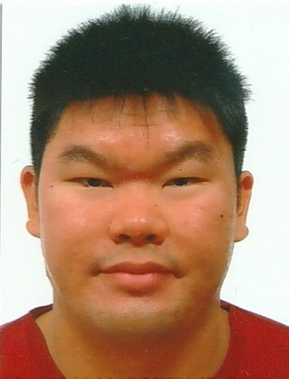
TOMOWORK GOAL SETTING WORKSHEET
NAME
Christopher Lim Zhan-Xin
INSTITUTE
Nanyang Polytechnic
GOAL START DATE
20 MARCH 2023
GOAL COMPLETION DATE
1 JUNE 2023
MY CAREER GOAL IN 2 YEARS
WORK
I like to work as an illustrator, cartoonist, graphic designer and 2D generalist.
LEARNING
I want to learn about social media, the different trends on design and style, and different skills on comics, graphics and illustrations in both traditional and digital methods.
ACTIVITIES
I like to participate in visiting the art exhibitions ,volunteering in donation drive and swimming.
5 THINGS I WANT TO ACHIEVE FROM TAP (Please include more than 1 soft skills)
ACTION THAT WILL HELP ME TO REACH MY GOAL
REVIEW
(REVIEW BY 31 MAY MORNING)
1 | Be better prepared for open employment.
2 | Get more experience in teamwork
3 | Get more experience in communication skills
4 | Get more experience in listening skills
5 | Learn the new skills in digital marketing
1 | Participate in the project, given by the company. Contribute well to the the project
2 | Be responsible in a group member. Contribute well in a groupwork activities.
3 | Try to interact with team members. Ask the important questions if needed.
4 | Try to focus on lectures and discussions. Ask questions to clarify if needed.
5 | Participate in taking courses online, diligently.
1
2
3
4
5
COMMENTS FROM FACILITATORS

